Slide 1

Understanding the Enrollment Rate Drop in Key Account Motion
January 31, 2019

Slide 2
Presentation Outline
Background
Methods
KA motion enrollment rate
Comparison among enrolled members
Demographics, health, claims
Comparison among active members
Demographics, health, claims
Next steps

Slide 3
BACKGROUND
Sizeable drop in Key Account motion enrollment rate
July 2018 monthly motion report:
Enrollment rate
From 64% in July 2017 down to 42% in July 2018
Active rate
From 61.9% in July 2017 down to 44.3% in July 2018
Killer questions:
How do member characteristics, particularly those related to health, compare?
Between those that were eligible in July 2017 and July 2018
Between those that were enrolled in July 2017 and July 2018
Between those that were active in July 2017 and July 2018

Slide 4
METHODS
Data source: identified via pharmacy and medical claims data with UHC
Population: Members of employers eligible for Key Account Motion
Time period:
Group 1: July 2016 – July 2017
Group 2: July 2017 – July 2018
Definitions:
- Eligible: enrolled in UHC and eligible to participate in KA motion program
- Enrolled: enrolled in KA motion program
- Active: had at least 100 steps during at least a day, and do not have an
incentive adjustment < $40 during the month
Amounts > 99.5 percentile of extreme normalized values were removed from analyses

Slide 5
KA MOTION ENROLLMENT RATE
How many have enrolled in the program?
There was a sizeable drop in the enrollment rate in the Key Accounts Motion program.
Year Month | Eligible | Enrolled | Enrollment Rate
July 2017 | 14071 | 9730 | 69.1%
July 2018 | 36438 | 16672 | 45.8%

Slide 6
AMONG ELIGIBLE MEMBERS
Difference in Demographics
No sizeable differences in demographics between the groups of eligible members
Demographic Comparisons
 | July 2017 (N=14071) | July 2018 (N=36438) | p-value | Effect Size Magnitude
Age | 44 | 43 | < 0.01 | Negligible
%F | 46.6% | 51.0% | < 0.01 | Negligible
Subscriber | 79.4% | 79.0% | 0.24 | ---
Area
%R | 26.1% | 21.3% | < 0.01 | Negligible
%S | 42.9% | 46.1% | < 0.01 | Negligible
%U | 31.1% | 32.5% | < 0.01 | Negligible
Median Income | $61,004.9 | $62,052.3 | < 0.01 | Negligible
Notes:
Small except age, income

Slide 7
AMONG ELIGIBLE MEMBERS
Difference in RAF and Prevalence Conditions
July 2018 have RAF scores 0.14 lower
Continuous enrollment shows no difference in RAF scores
RAF Score and Percentage Prevalence Comparisons
 | July 2017 (N=6772) | July 2018 (N=8880) | p-value | Effect Size Magnitude
Type 2 Diabetes | 0.6% | 0.5% | 0.62 | ---
Hypertension | 9.8% | 10.0% | 0.40 | ---
Depression and Anxiety | 6.2% | 6.6% | 0.06 | ---
COPD | 0.6% | 0.5% | 0.53 | ---
Congestive Heart Failure | 0.3% | 0.3% | 0.67 | ---
Rheumatoid Arthritis | 0.1% | 0.1% | 0.77 | ---
Chronic Pain | 10.8% | 11.0% | 0.485 | ---
RAF Score | 0.92 | 0.83 | < 0.01 | Negligible
Notes:
RAF score from negligible to considerable
Table for CE population, negligible

Slide 8
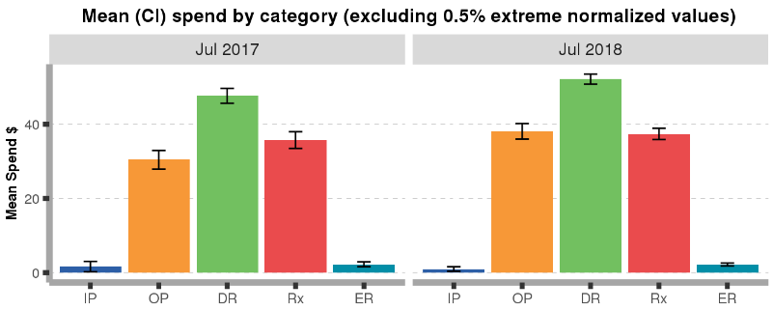
AMONG ELIGIBLE MEMBERS
Difference in Healthcare costs
July 2018 have had $20 higher total costs, $8 higher for OP, $6 higher for DR
Healthcare Spending Comparisons
 | July 2017 (N=6772) | July 2018 (N=8880) | p-value | Effect Size Magnitude
Inpatient | $1.61 | $0.98 | 0.34 | ---
Outpatient | $30.41 | $38.12 | < 0.01 | Negligible
Doctor Visit | $46.67 | $52.18 | < 0.01 | Negligible
Drugs | $35.73 | $37.40 | 0.24 | ---
Emergency Room | $2.23 | $2.18 | 0.89 | ---
Total Allowed Amount | $188.39 | $208.21 | < 0.01 | Negligible

Slide 9
AMONG ELIGIBLE MEMBERS
No practical differences between healthcare costs
Group | Count | Mean | SD
July 2017 | 13,917 | 188.4 | 636.4
July 2018 | 36,068 | 208.2 | 687.6

Slide 10
KA MOTION ACTIVE RATE
How many enrolled members are active in the program?
There was a drop in the percent of who are active among those enrolled
Year Month | Active | Inactive | Active Rate
July 2017 | 6772 | 2958 | 69.6%
July 2018 | 8880 | 7792 | 53.3%

Slide 11
ACTIVE AMONG ENROLLED
Difference in Demographics
No practical differences in demographics among the groups of active among enrolled members
Demographic Comparisons
 | July 2017 (N=6772) | July 2018 (N=8880) | p-value | Effect Size Magnitude
Age | 45 | 44 | < 0.01 | Negligible
Gender
%F | 48.5% | 54.1% | < 0.01 | Negligible
%M | 51.5% | 45.9% | < 0.01 | Negligible
Subscriber | 79.2% | 82.3% | < 0.01 | Negligible
Area
%R | 25.6% | 19.8% | < 0.01 | Negligible
%S | 42.6% | 48.0% | < 0.01 | Negligible
%U | 31.9% | 32.2% | < 0.01 | Negligible
Median Income | $61,303.21 | $63,288.62 | < 0.01 | Negligible

Slide 12
ACTIVE AMONG ENROLLED
Difference in RAF and Prevalence Conditions
No practical differences in RAF and percentage of prevalence conditions among the groups of active among enrolled members
RAF Score and Percentage Prevalence Comparisons
 | July 2017 (N=6772) | July 2018 (N=8880) | p-value | Effect Size Magnitude
Type 2 Diabetes | 0.5% | 0.5% | 0.93 | ---
Hypertension | 9.7% | 10.8% | 0.02 | Negligible
Depression and Anxiety | 5.6% | 6.4% | 0.02 | Negligible
COPD | 0.4% | 0.4% | 0.95 | ---
Congestive Heart Failure | 0.1% | 0.2% | 0.36 | ---
Rheumatoid Arthritis | 0.1% | 0.1% | 0.43 | ---
Chronic Pain | 10.2% | 11.4% | 0.02 | Negligible
RAF Score | 0.92 | 0.83 | < 0.01 | Negligible

Slide 13
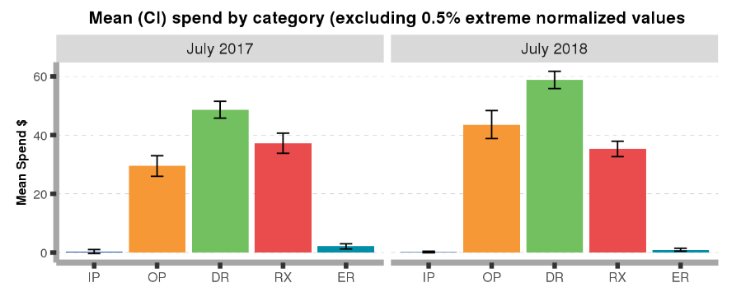
ACTIVE AMONG ENROLLED
Difference in Healthcare Spending
No practical differences in healthcare costs among the groups of active among enrolled members
Healthcare Spending Comparisons
 | July 2017 (N=6772) | July 2018 (N=8880) | p-value | Effect Size Magnitude
Inpatient | $0.35 | $0.17 | 0.60 | ---
Outpatient | $29.50 | $43.61 | < 0.01 | Negligible
Doctor Visit | $48.70 | $58.84 | < 0.01 | Negligible
Drugs | $37.26 | $35.31 | 0.37 | ---
Emergency Room | $2.09 | $0.94 | 0.02 | Negligible
Total Allowed Amount | $169.96 | $191.37 | 0.02 | Negligible

Slide 14
ACTIVE AMONG ENROLLED
Difference in PMPM Spending
July 2018 active among enrolled members have higher month on month spending on healtcare
PMPM Spending Comparisons
 | July 2017 (N=6772) | July 2018 (N=8880) | Obsereved Difference | Bootstrap CI
PMPM | $331.0 | $385.6 | $54.6 | ($7.54, $102.32)

Slide 15
CONCLUSION
Overall Findings
There are no major differences between the two groups compared
In general, while there is statistical evidence that some variables are different, it is believed that the members belonging in July 2018 have the same characteristics as those in July 2017.

